Slide 1
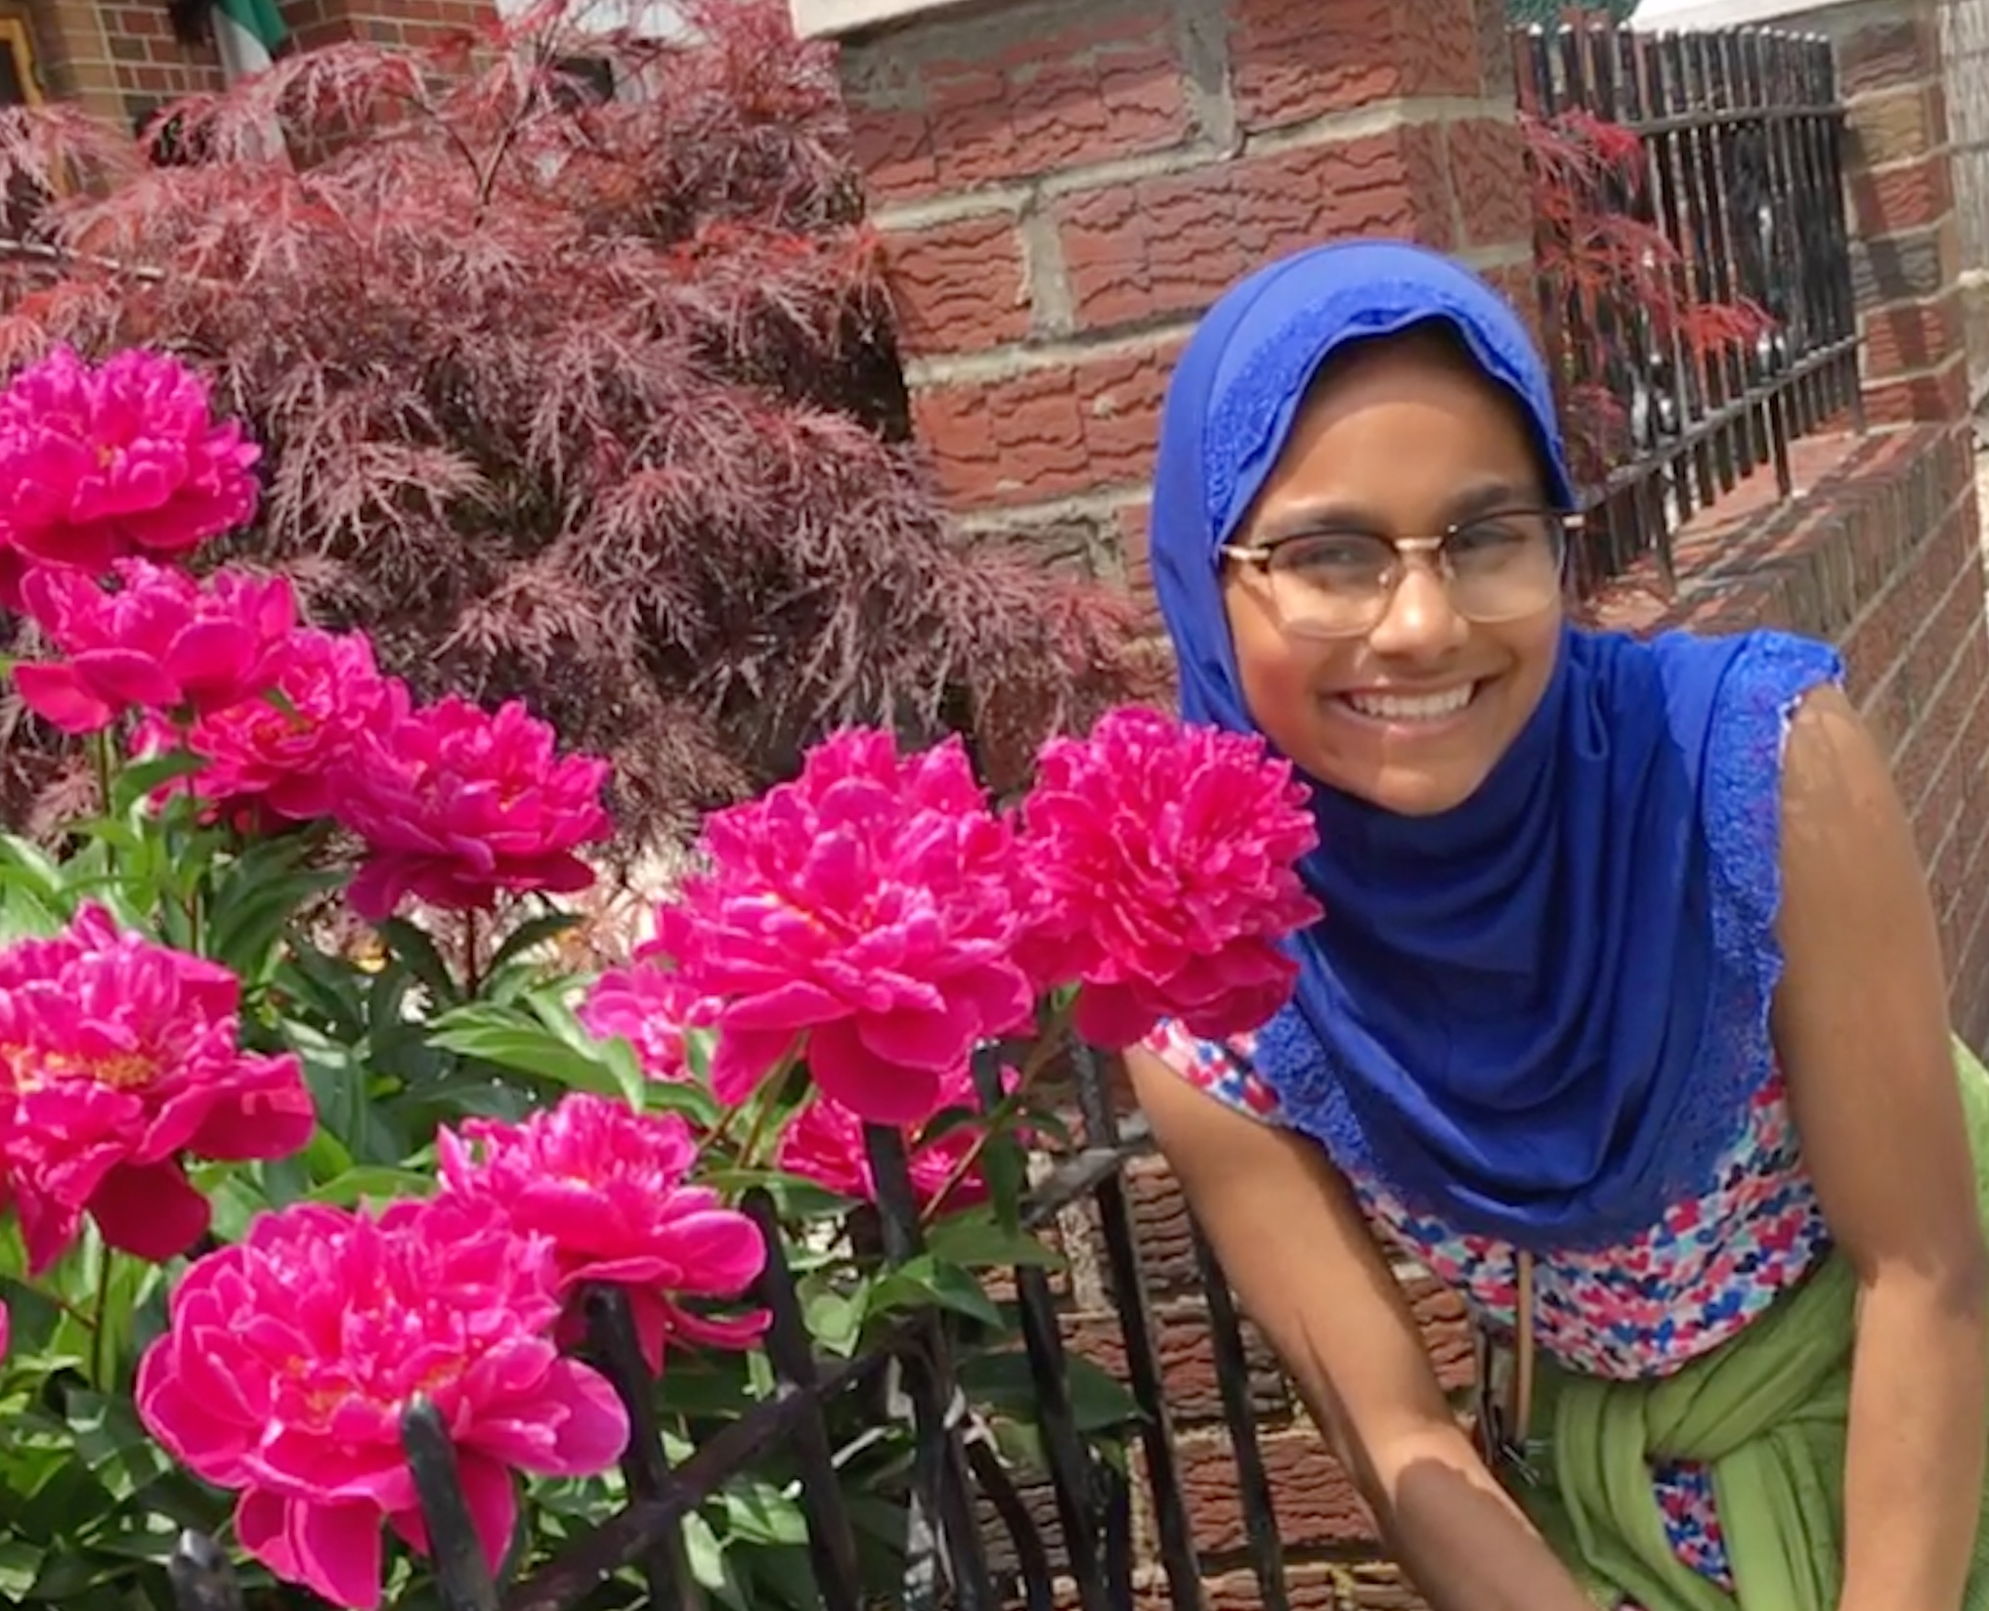
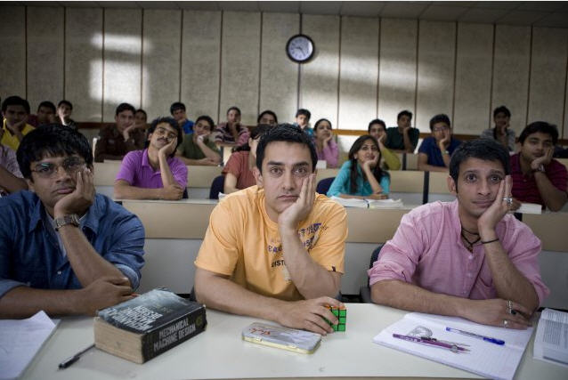
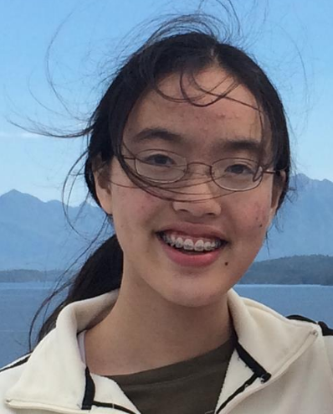
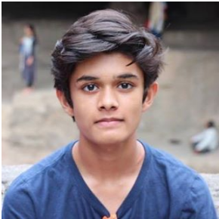
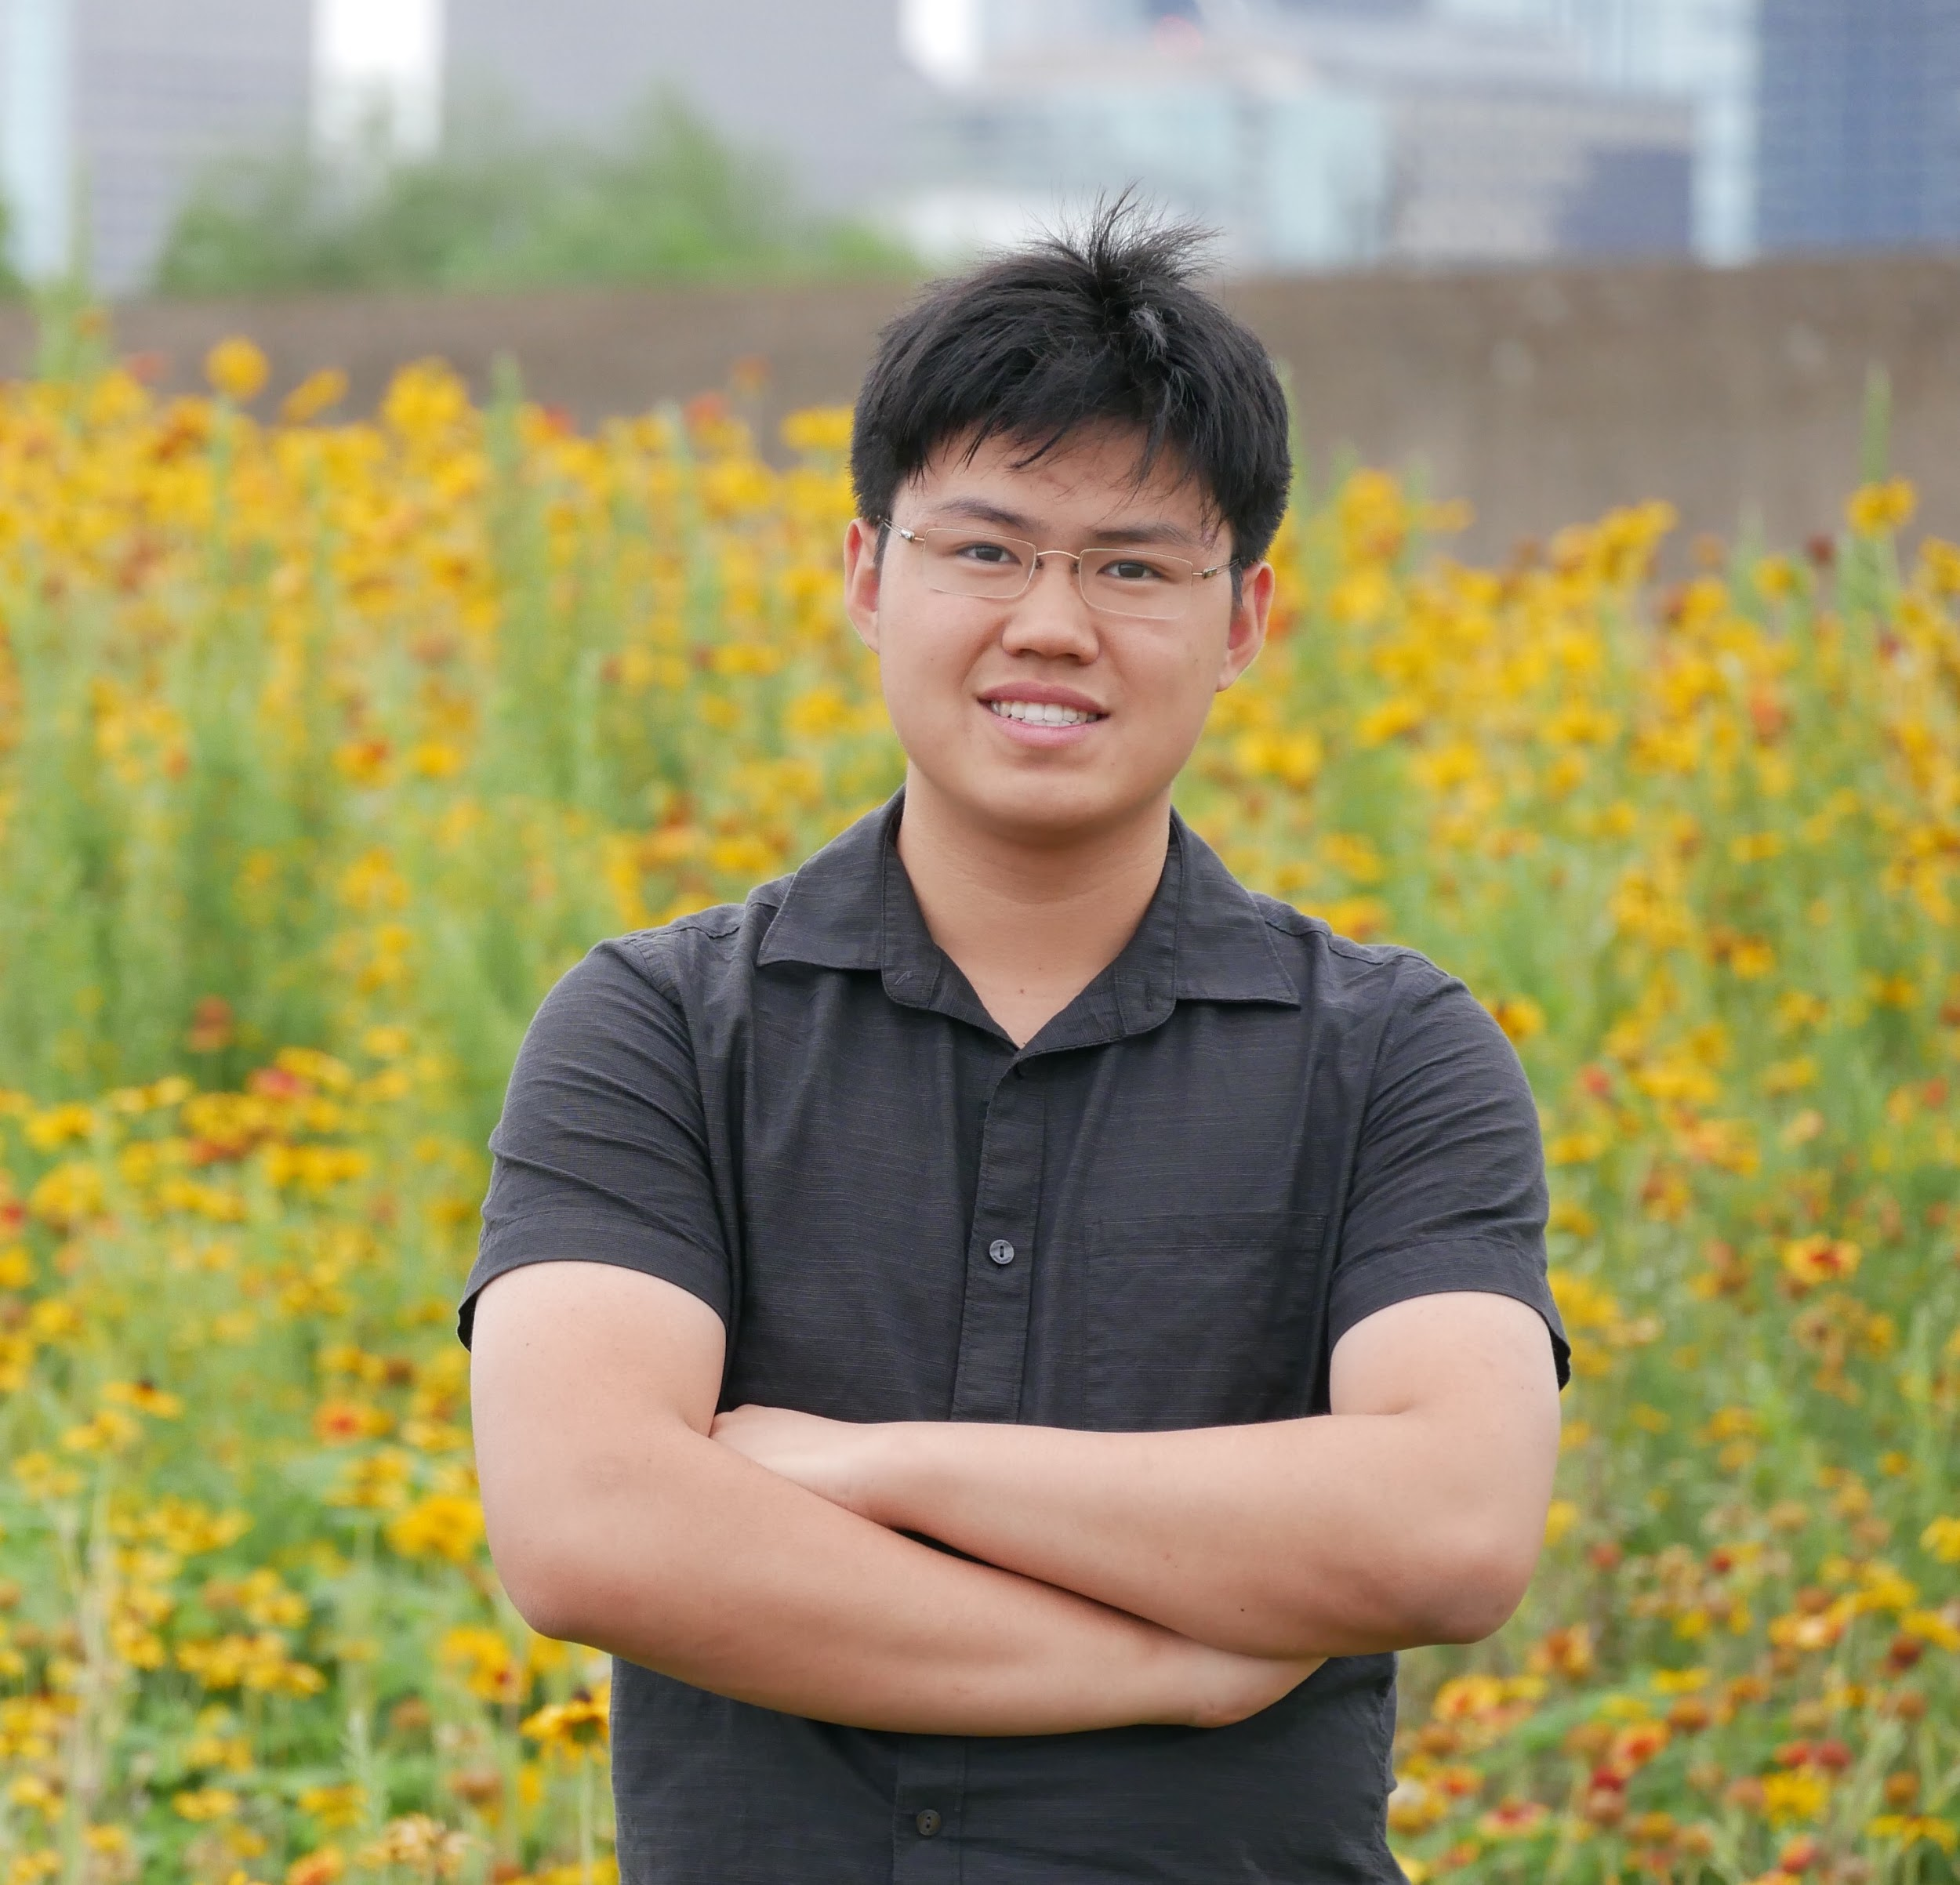

Mammogram Analysis
Challenge Completed by Ai^3
Amena +
Amena

Slide 2
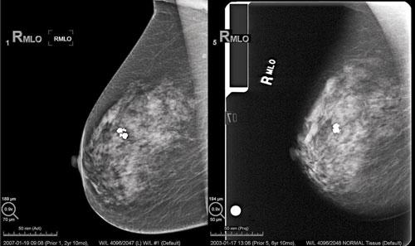
Mammography
Early detection of breast cancer via X-Rays → earlier treatment to prevent damage
False positives (more common) → biopsy or screenings + anxiety
False negatives → false sense of security, delays in treatment
Notes:
Biopsy = tissue test/examination
False negatives: cancer missed/undetected 20% of the time in screenings

Slide 3
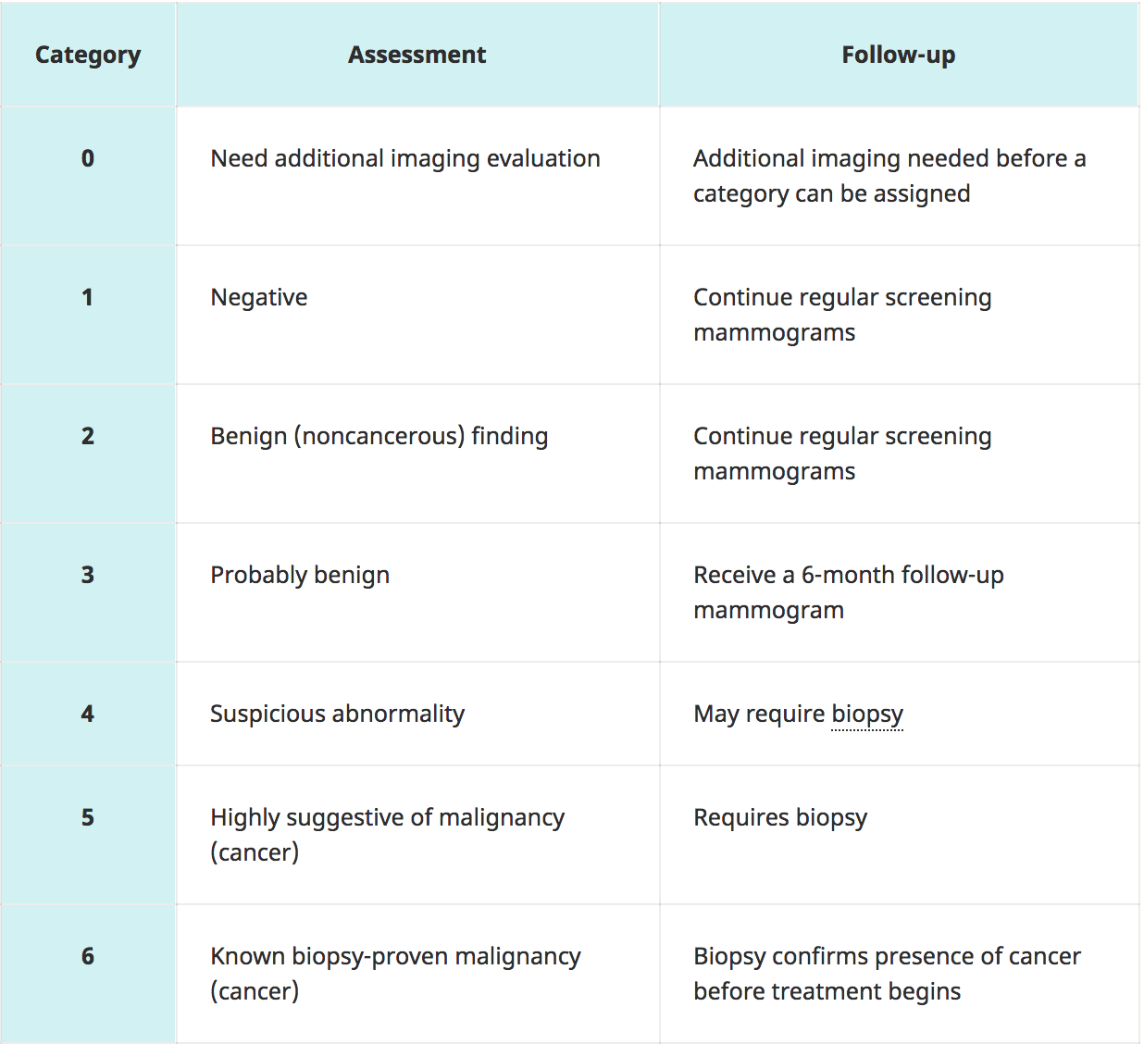
Breast Imaging Reporting and Database System
Seven standardized categories/levels for radiologists
←
4 categories of breast density:
Almost entirely fatty
Scattered areas of tissue density
Heterogeneously dense
Extremely dense
Source: NIH

Slide 4
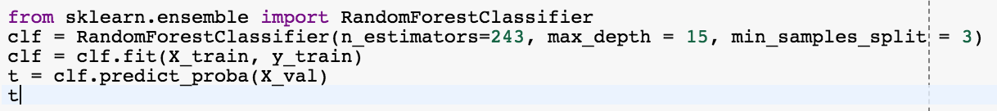
Random Forest - Binary
Utilized the raw data (train_images and train_simple_labels[‘Label’])
No unique indices and didn’t shuffle
Split the data into training and validation
Reshape the 2D images to 1D
Normalize the data
Random forest classification with 240 estimators, 15 max_depth, and 3 samples to split internal nodes
No gridSearch -- ONLY PatNet
Improved ROC from 0.5 to 0.914
Improved CM from -1476 to 1413

Slide 5

/255
Is this normalizing data?

Slide 6
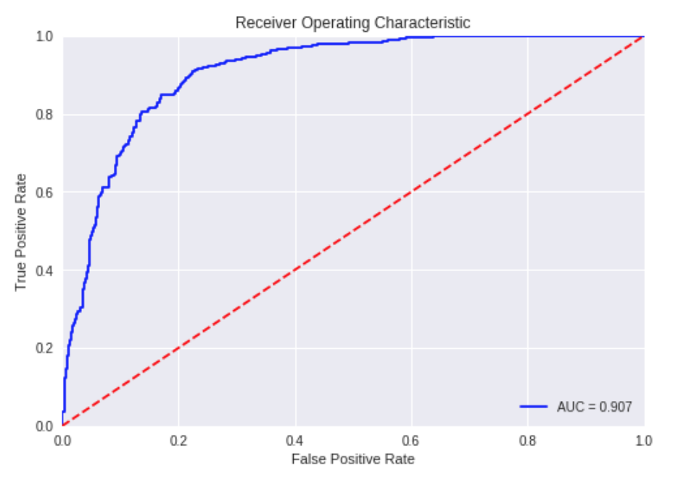
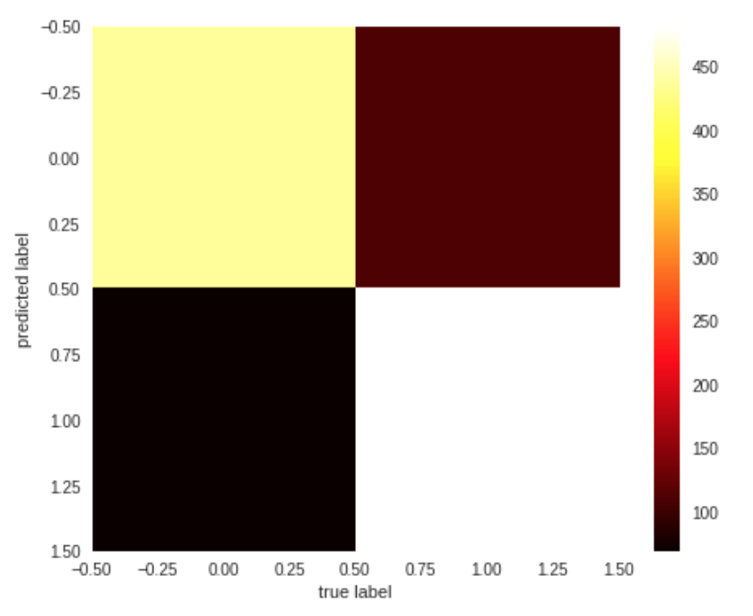
Random Forest - Binary
ROC Curve
Confusion Matrix

Slide 7
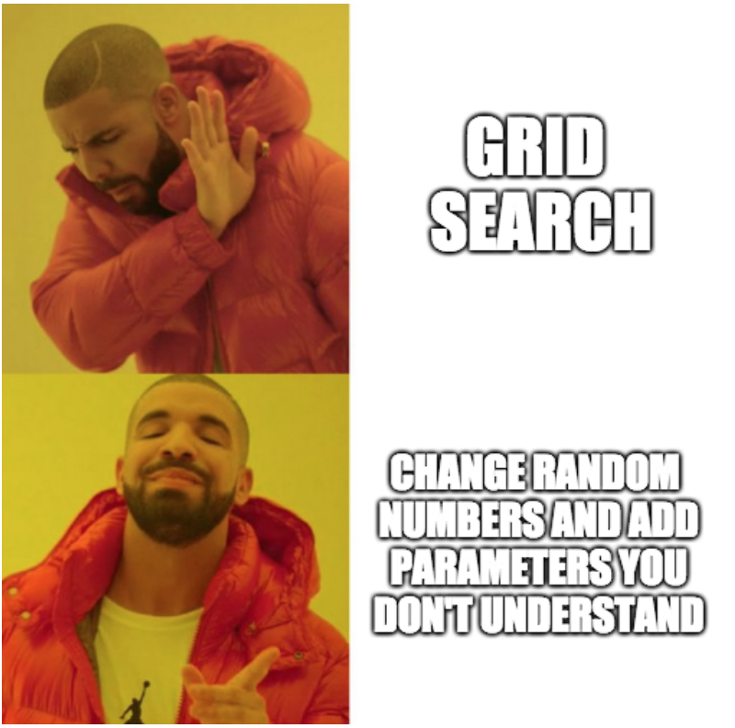
Methodology

Slide 8


Apply Random Forest
CMM: 1071
AUC: .907
Submit
pickle file
picklerick.p
CMM: 1413
AUC: .914
CMM: 1413
AUC: .914

Slide 9
Random Forest - multiclass
Used the train_complex_labels
Random forest with 250 estimators, max_depth of 15, and 4 minimum samples to split
Got 0.871 auc and 45 confusion matrix value
Suggestion for improvement: CHANGE THRESHOLD
Try to feed the probabilities to a SVC to pick best guess ~ don’t know how ◉︵◉ (T_T)
Figure out why random forest is working better than CNN

Slide 10
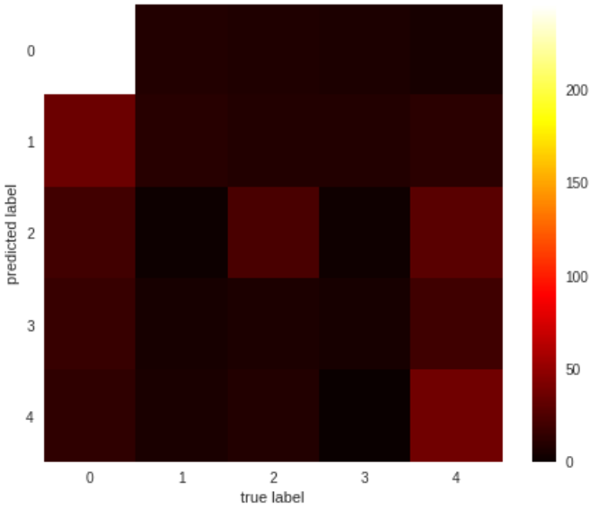
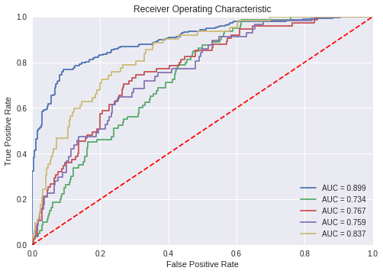
Used Gaussian Filters for better normalization
CM score: -63 :/

Slide 11
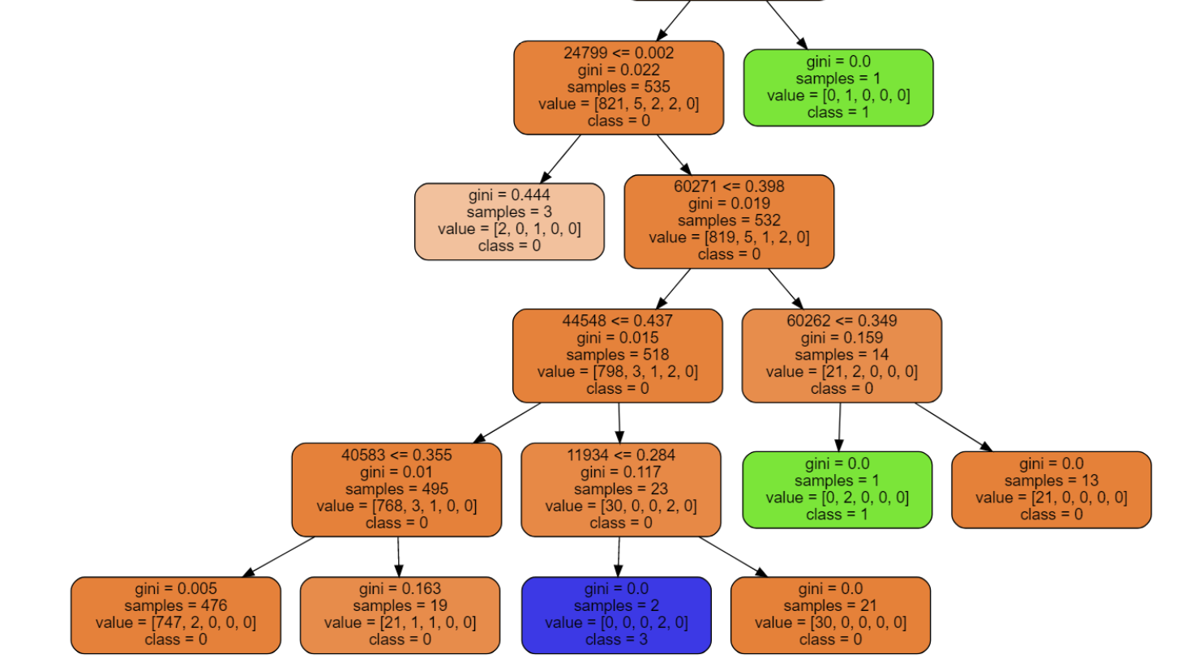
Trees are choosing specific locations of pixels and analyzing their lightness

Slide 12
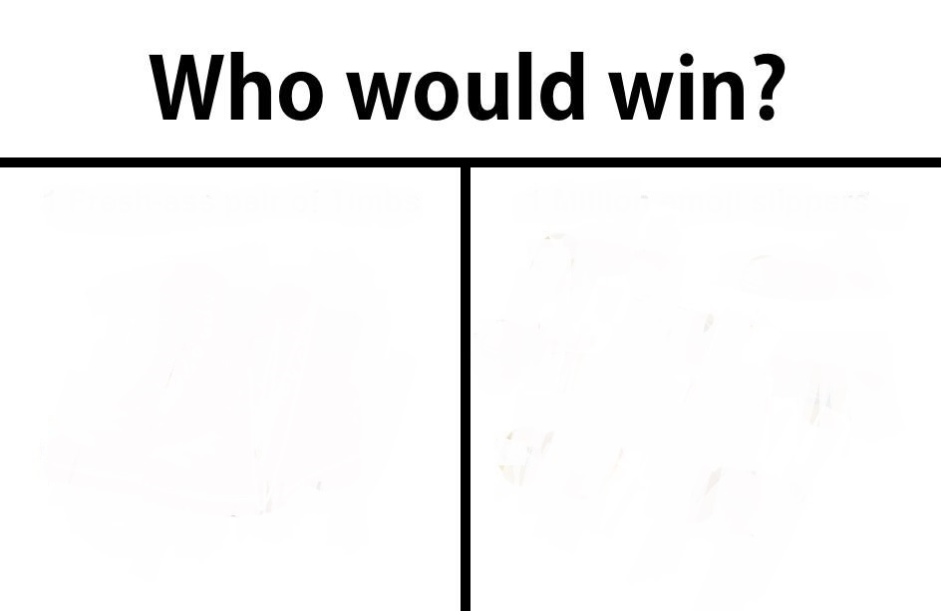
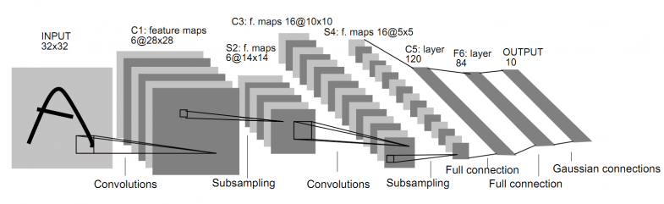

Some tree bois
A class of deep feed-forward biology-inspired artificial neural networks composed of a complex architecture of convolutional, pooling, fully connected, and normalization layers

Slide 13

But y it work tho

Slide 14
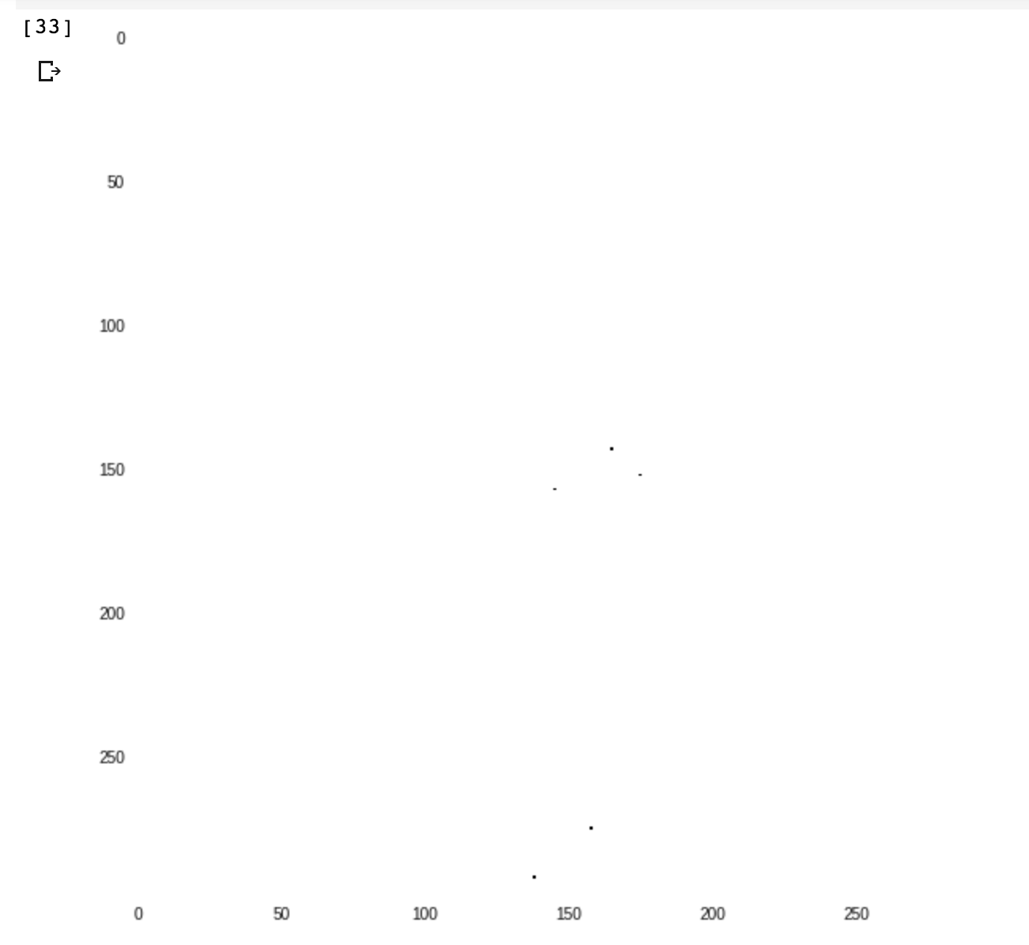
Traced an image down a tree to see how it classified a zero class
Question: light/dark
Looking at neighborhoods

Slide 15
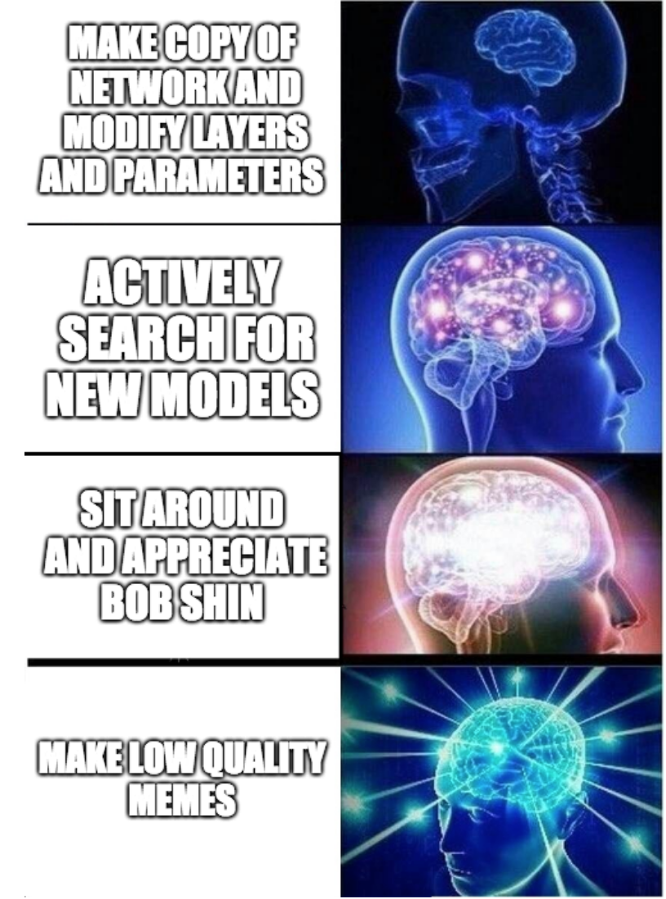
...While neural network is ‘training’

Slide 16
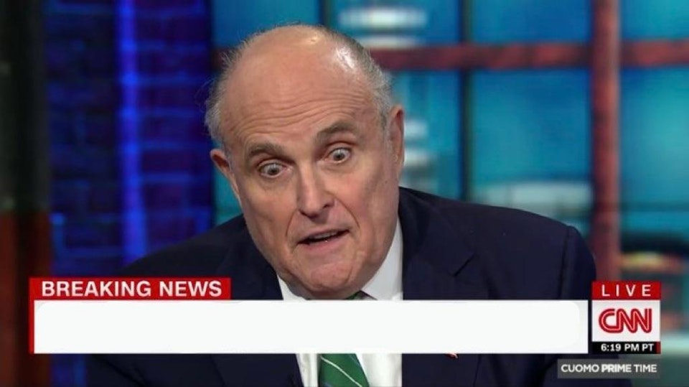
Runtime dies for the 32nd time in one hour

Slide 17
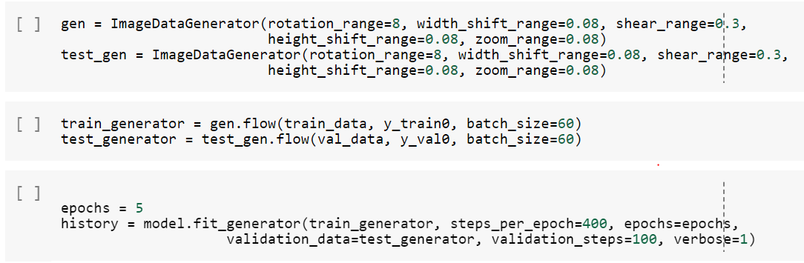
Data Augmentation

Slide 18
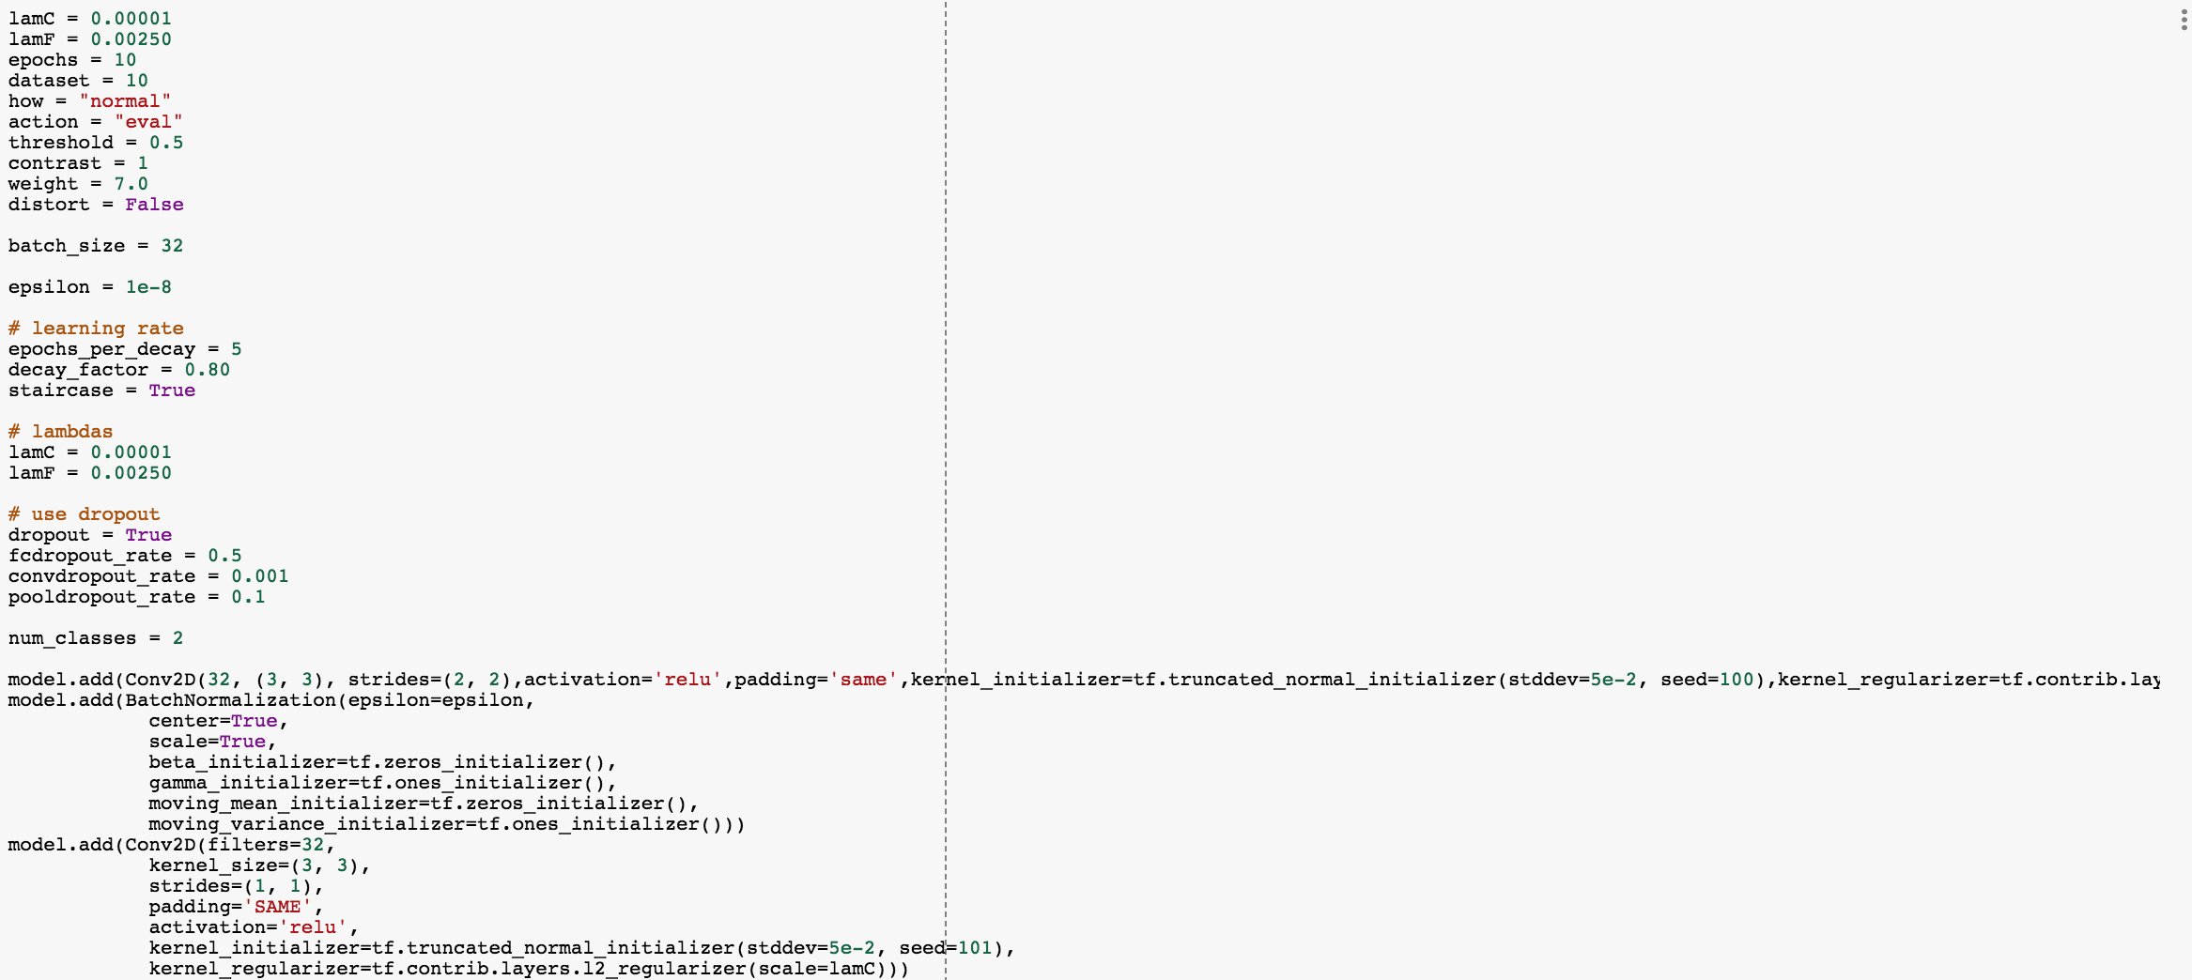

Slide 19
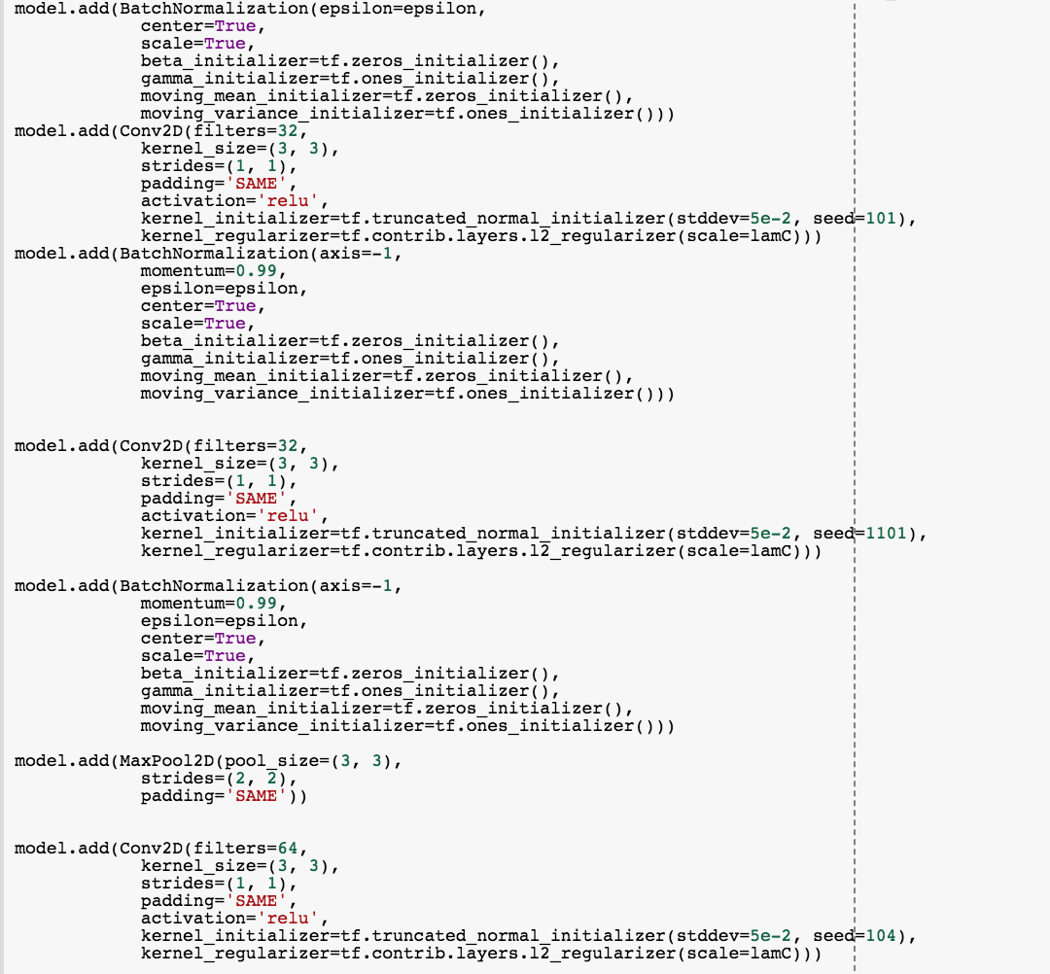

Slide 20
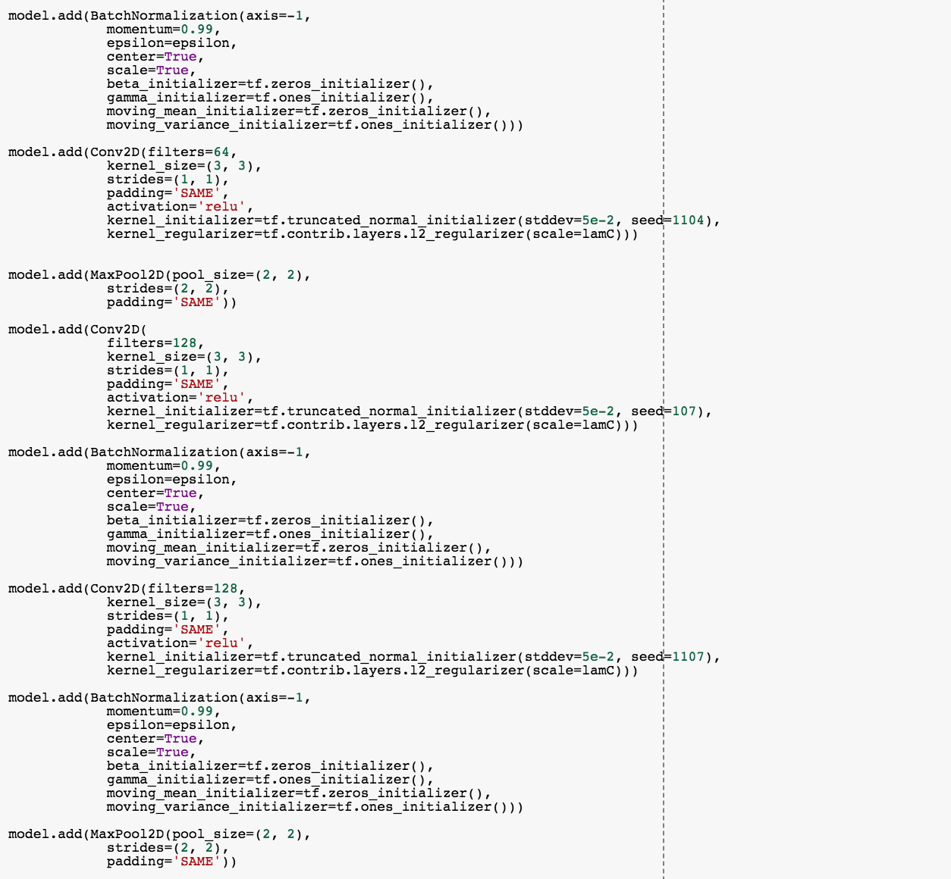

Slide 21
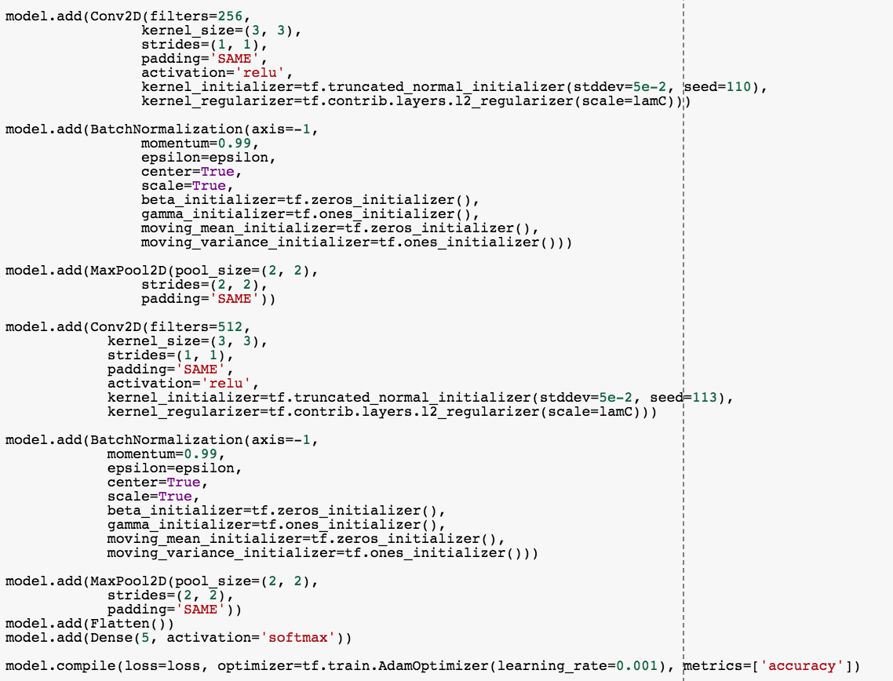

Slide 22
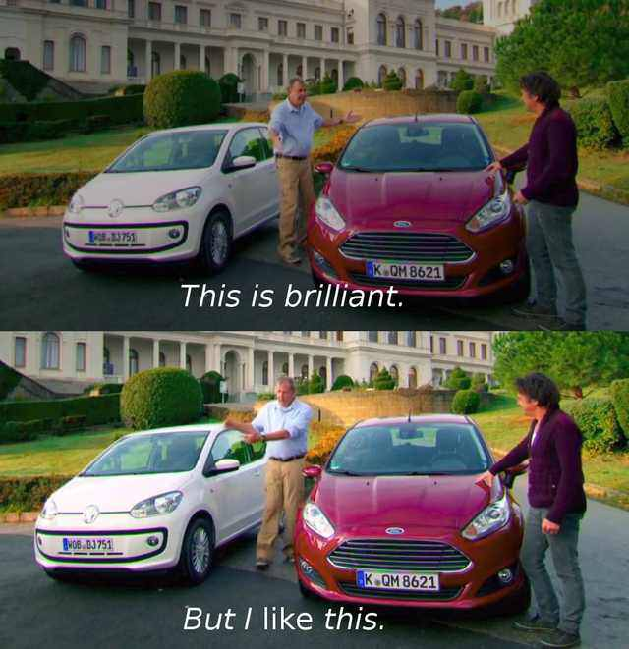
2 min / epoch
Caroline’s Computer
1 hour / epoch
Caroline’s Computer

Slide 23

Running MobileNet from Scratch
Runtime dies for the 32nd time in one hour
Neil’s Macbook Air (HECTOR)

Slide 24
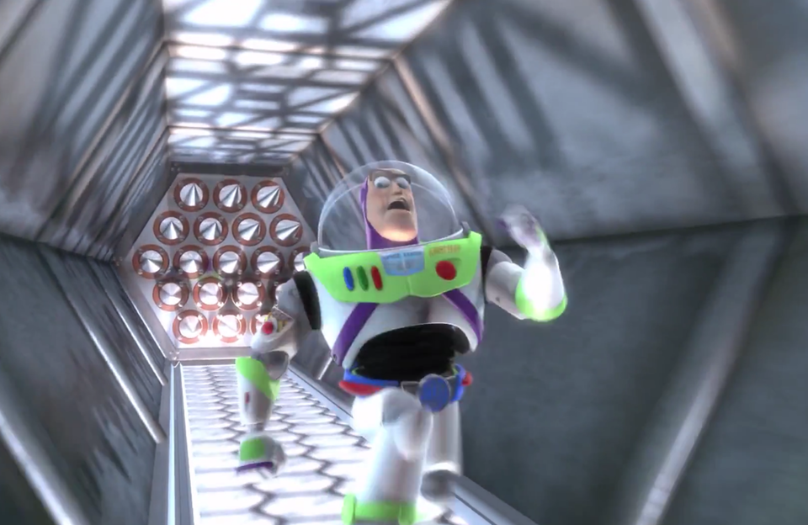
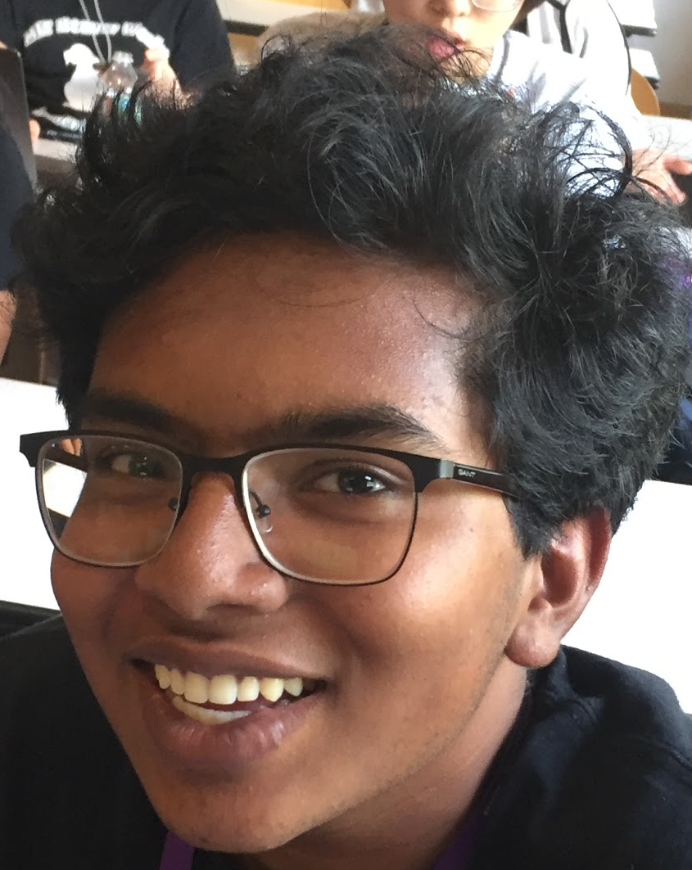
Complex/ established mobile architectures
PhalishaNet

Slide 25
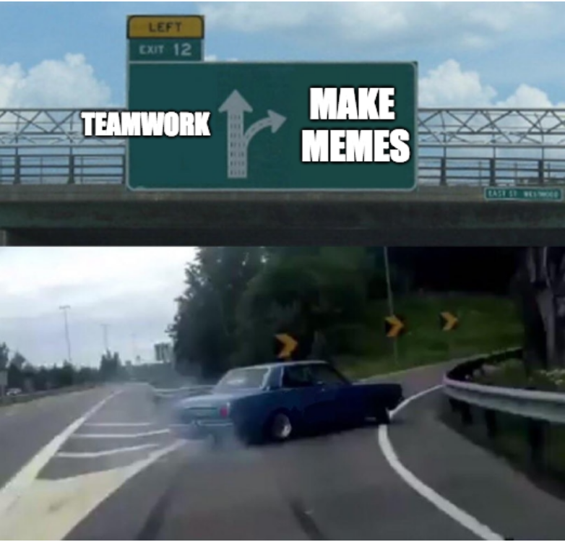
“MemeTeamwork makes the dream work.”
Abraham Lincoln

